Slide 1
First Order Plus Time Delay (FOPTD) Model or Time Delay Time Constant (TDTC) model
ME
Universitas Pertamina
2020

Slide 2
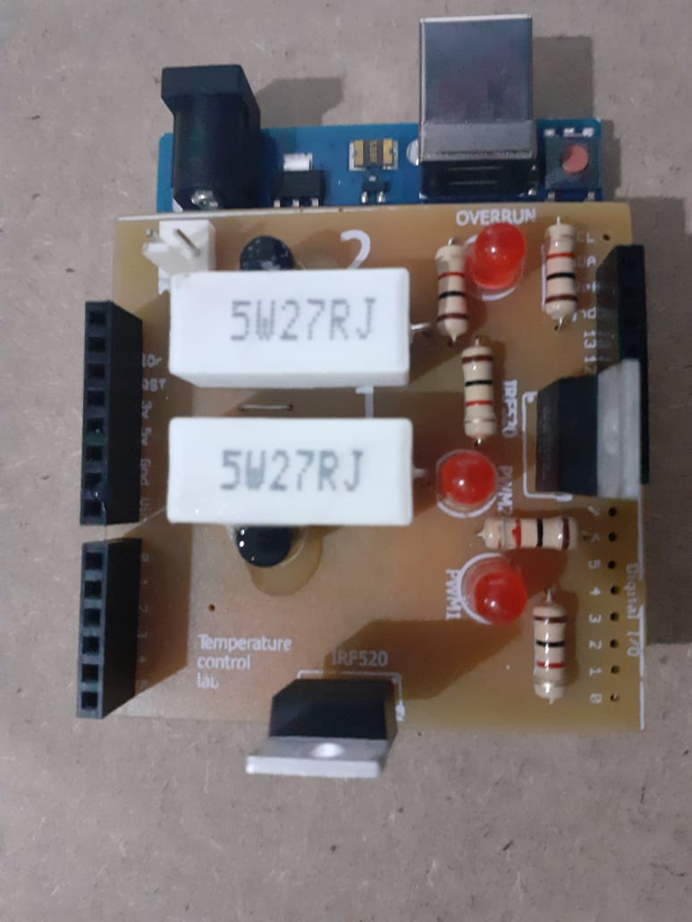
Step response Experiment

Slide 3
Apply an input of 50%.
Run the Simulink, record the time, the input and the output.
Run for at least for 1500 seconds.

Slide 4
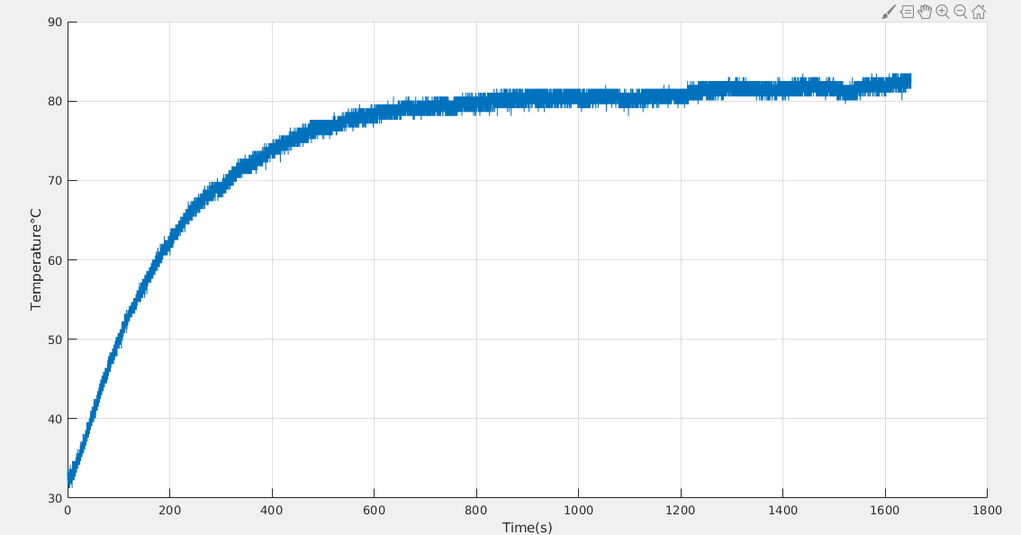
50% of Input PWM

Slide 5
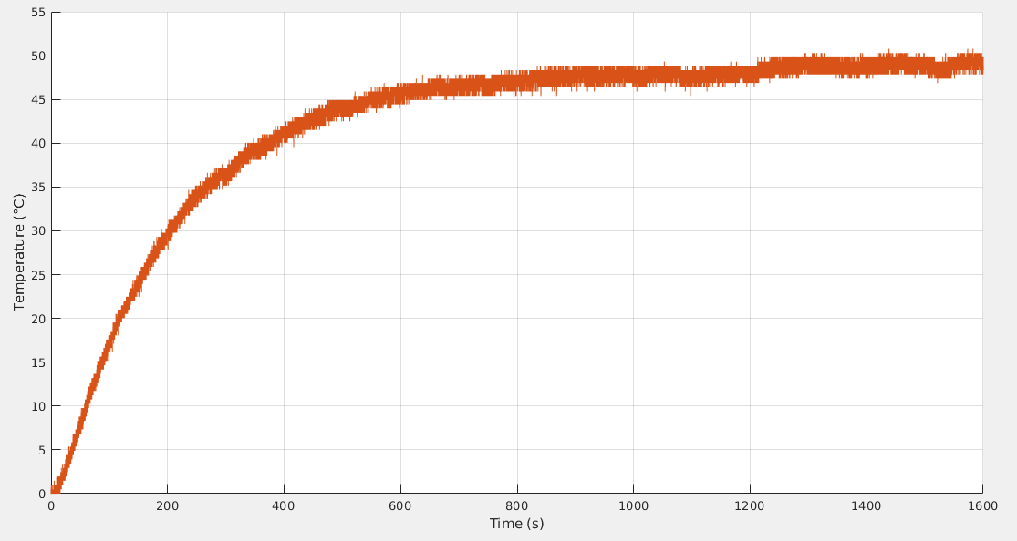
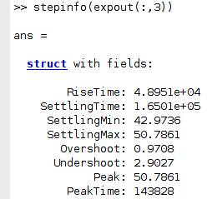

Temperature offset has been removed
$$y_{ss}$$

Slide 6
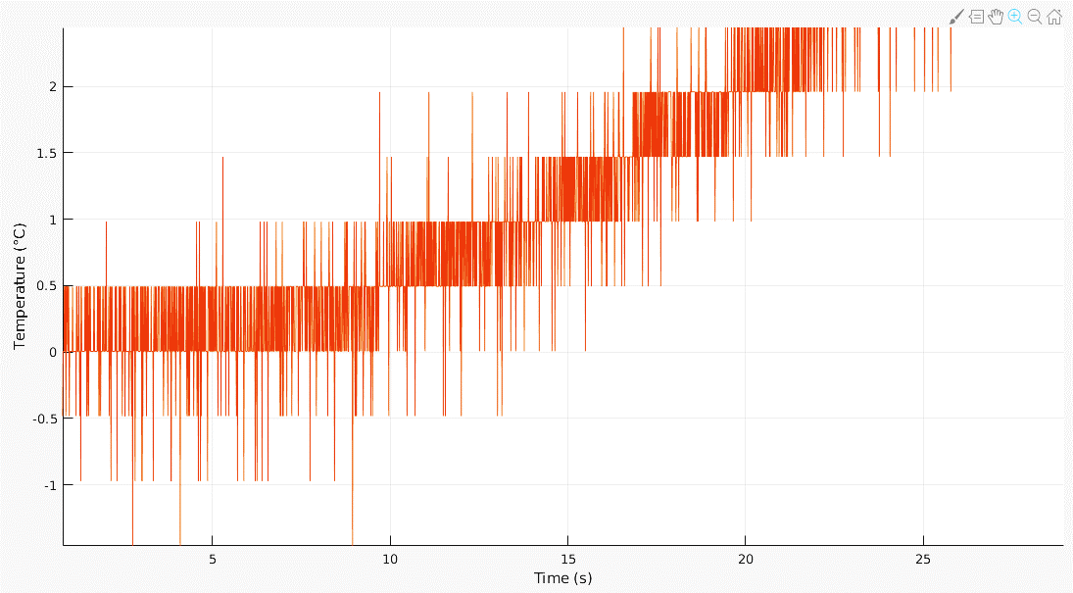




Zoomed-in around $t=0$
Time delay
$$θ=10$$
$$y_{0}$$
Input starts at $t=0$

Slide 7
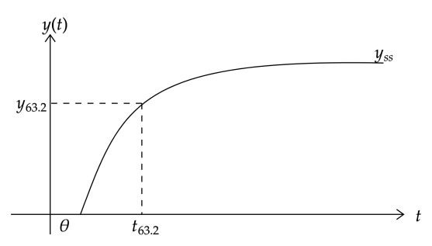

The TDTC model
$$G\left(s\right)=K_{ss}\frac{e^{−θs}}{τs+1}$$

Slide 8
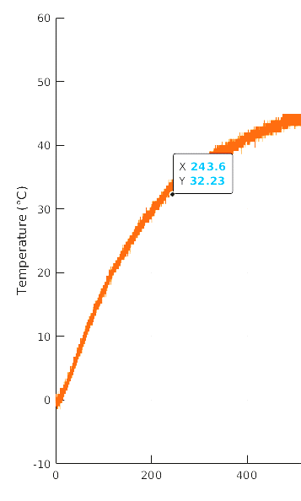
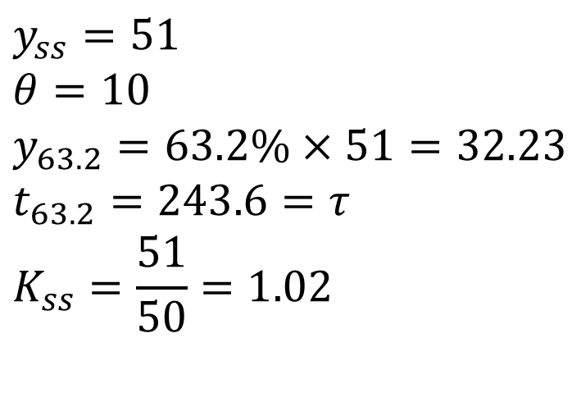

Find all the parameters
$$y_{ss}=51$$
$$θ=10$$
$$y_{63.2}=63.2\%×51=32.23$$
$$t_{63.2}=243.6=τ$$
$$K_{ss}=\frac{51}{50}=1.02$$
$$τ$$

Slide 9
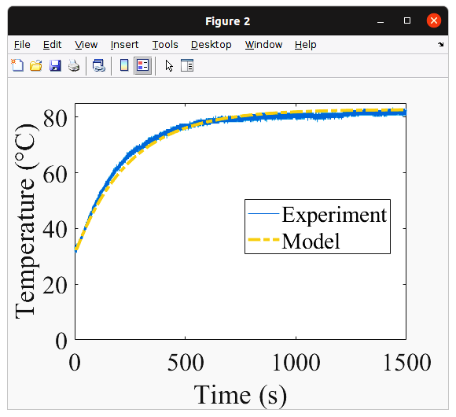
Results

Slide 10
Calculate the absolute error (for every time point) and plot the error.
Can you also find the integral of the absolute error (the area under the curve that you just found)?

